Slide 1







NICOLAUS COPERNICUS UNIVERSITY
in Toruń

Slide 2

















  Internationalisation - where are we now?

Slide 3
Items
3-9 NCU in brief
10-11 External opportunities, legislation
13-16 Internal opportunities, documents
17-24 Structures and units; exchange and Erasmus
25-29 What we offer
30-32 Are we satissfied?
Info

Slide 4
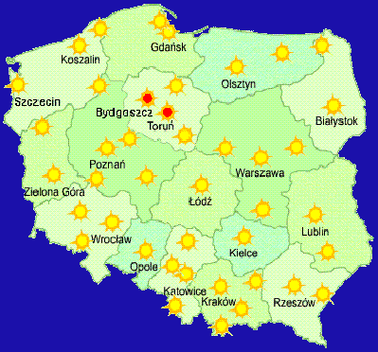
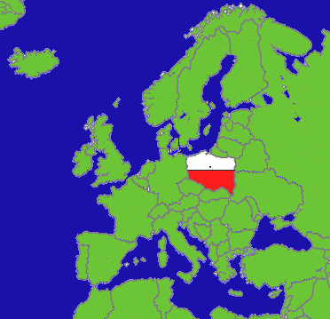

Slide 5
Established in 1945
16/17 faculties, 31 000 students
  50% on campus = full time, 50% off campus = part time
    77 study courses, >100 specialisations
    21 doctoral courses (844 students)
    75 post-diploma courses (1400 students)
    MOST 100 outgoing, 20 incoming students/year
4250 employees
  2120 academic teachers
    595 full professors

Slide 6
NCU today
The largest university in northern Poland
4th in the „Wprost” and „Perspektywy” ranking
MBA course
University Affiliated High School – GiLA
Third Age University
Children’s University
University Museum

Slide 7
NCU today
Allianace Francaise
British Council Library
Jean Monet Centre of European Studies
Centre for Polish Lang.& Culture for Foreigners
Open&Distance Learning Centre
FAMO Laboratory
Polar Research Station – Spitsbergen
10m Telescope in RSA

Slide 8
Authorities
The Senate (96 repr. incl. 14 students)
Rector Magnificus
Vice-Rector for Education & HR (QA)
Vice-Rector for Research & Int. Relations (R&D projects)
Vice-Rector for Students Affairs (SM Erasmus)
Vice-Rector for Development
Vice-Rector for Collegium Medicum
Deans of Faculties - QA

Slide 9
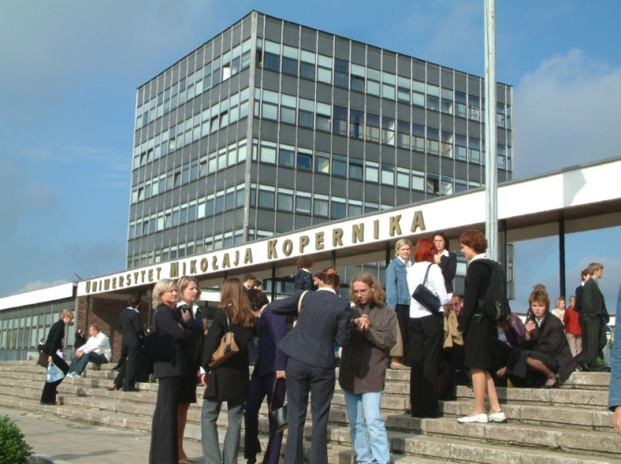
  Major events
    >90 conferences/year
      ~10 international congresses
    Science and Art Festival
    Medicalia
    Career Days
    Higher Education
    Promotion Fair

Slide 10

Internationalisation and QA
External opportunities
Magna Charta Universitatum
Bologna Process
NCU among signatories

Slide 11
Internationalisation and QA
External opportunities
New Higher Education Act – March 2011
  Training effects in focus
  Learning outcomes as determinant of quality
  Rector responsible for QA mechanisms
  Monitoring of graduates’ careers
  Courses in response to labour market
  Cooperation and advising of companies
  Mobility strongly supported

Slide 12
Internationalisation and QA
External opportunities
Polish Accreditation Committee
New tasks – learning outcomes and teaching effects in the focus
Acreditation at NCU – PKA 45 courses
- UKA 4 courses

Slide 13
NCU - Assumptions of internationalisation
Aim:
  opening to external world
  preparation of graduates for European labour market
  input to innovative technology
Tools:
  student & staff exchange
  international R&D projects
  quality policy

Slide 14
Key documents for internationalisation
Internal opportunities
Mission
„The University is aiming at the highest quality of education, scientific research, clinical practice and artistic creativity”.

Slide 15
Key documents for internationalisation
Internal opportunities
New Strategy Statement
“The University as an HEI of European Dimension”
The University is “willing to adapt the structure of education to the requirements of the Bologna Declaration.”
The university as a „leader of education and research in the region”

Slide 16
Organisations
International
EUA – Association of European Institutions of Higher Education
EAIE – Auropean Association for International Education
LEO-NET – Leonardo Network for Academic Mobility
National
    KRASP – Conference of Rectors
    IROs FORUM – network of exchange offices of leading Polish universities

Slide 17
  International co-operation - structures
  Administrative units
    International Relations Office
    International Programmes Office
    Admissions and Student Affairs
    Recruitment Office for Medicine in English
    Career Service

Slide 18
  International co-operation - structures
  Rector’s Plenipotentiaries
  coordinator of the Bologna Process
  coordinator of ECTS
  coordinator of internationalisation of studies
  coordinator for international students

Slide 19
  International co-operation
  IRO:
    44 partnership agreements
      Oldenburg, Goettingen, Greifswald, Rostock
      Angers, Padova, Ferrara
      USA, Taiwan, Japan, Korea,
    2200 outgoing persons/year
    570 incoming /year
    student exchange: 480 out and 120 in

Slide 20


  IPO - European Research Programmes
  Over 150 international projects
  13 projects in 6FP
  7 projects in 7FP
  eContent+, Nature, Culture, Nato, Daphne

Slide 21
  IPO - European Educational Programmes
  Leonardo da Vinci
  TEMPUS
  EEA and Norway grants
  LLP
  Grundtvig, Comenius
  Virtual campus
  IP

Slide 22

  ERASMUS
  Code PL TORUN01
  Extended Erasmus University Charter
  number 46657

Slide 23
  ERASMUS
  In the Programme from 1998/9
    over 3200 outgoing students
    over 800 incoming students
    over 500 outgoing staff members

Slide 24

  277 partner universities in 2011/12
  420 outgoing students + 50 placements
  120 incoming students
  ~50 teachers exchange
  ~12 staff training mobility

Slide 25

What we offer :
  IPO service
  Faculty co-ordinators
  ECTS
  University accommodation
  Courses of Polish
  EILC

Slide 26
  Courses in foreign languages
  Student mentors
  Orientation weeks
  Social & integration programme
  Intercultural training
  ESN & student coordinator
  Evaluation questionnaire

Slide 27
  NEW!
    On-line recruitment
    Complex exchange management in USOS
    Use of MOODLE platform
    Counselling in English
    Health&safety package
    ECTS grading scale

Slide 28


  Related activities
  Scholarship and Training Fund
  Project „Polish-Norwegian Paths”
  3 mobility projects
  4 cooperation projects with Norwegian universities

Slide 29

  International promotion
  EAIE Copenhagen
  Educational Fair and visits in Kazakhstan
  Promotional trips to Japan, China, Korea
  Contract with an international recruiter
  Contract with SE and NO – medical studies

Slide 30
  Difficulties and obstacles
  Unbalanced international exchange
  Low quality of in-coming students; EDU-tourism
  Prejudice at home, few courses in English, language teaching policy
  No East-West exchange financing
  Qualification framework – too late and not yet implemented

Slide 31
  Difficulties and obstacles
  “Bolognisation of studies” regarded as a nuisance
  3+2 = decline in quality
  Less effects in „new” EU-countries
  Difficult to catch up with US education standards
  also with China, Australia; No improvement in rankings
  Brain drain and high unemployment rate among graduates
  universities as vocational schools?

Slide 32
  Difficulties and obstacles
  Insufficient internationalisation of research
  Too few projects coordinated

Slide 33
  Contact persons for TEMPUS –QATMI
  Marta Wisniewska mawi@umk.pl
  Responsible for outgoing students and educational projects
  Ewa Derkowska-Rybicka ewader@umk.pl
  Head of International Programmes Office & Institutional LLP Co-ordinator

Slide 34
  Information
  www.umk.pl
    incoming@erasmus.umk.pl
    outgoing@erasmus.umk.pl
    research@umk.pl

Slide 35

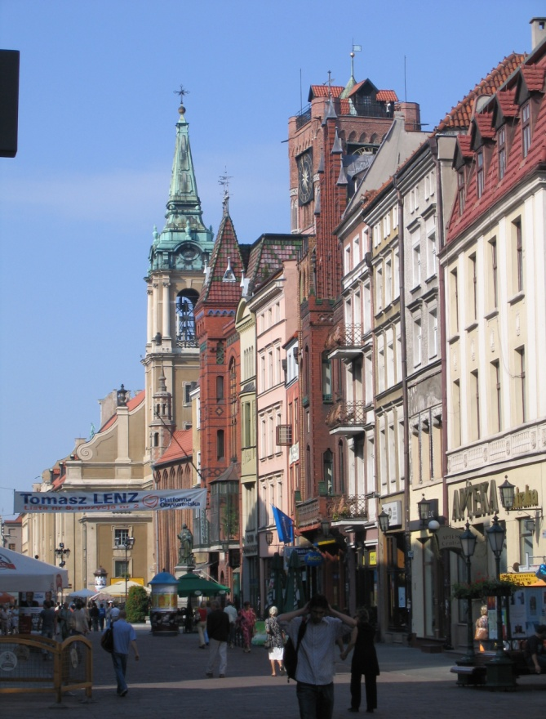

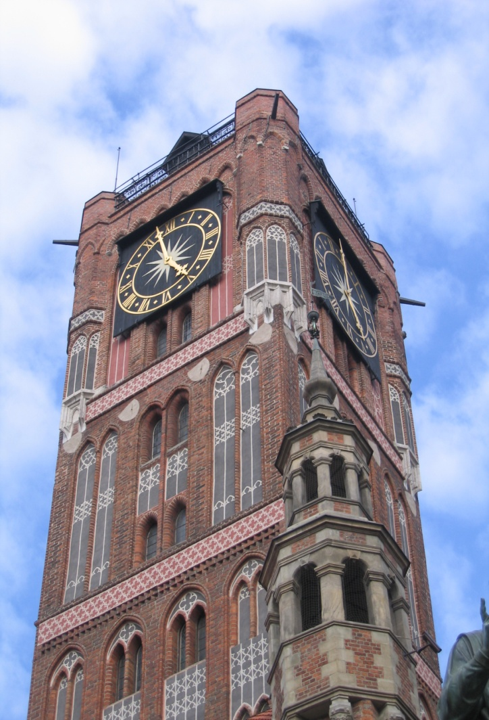
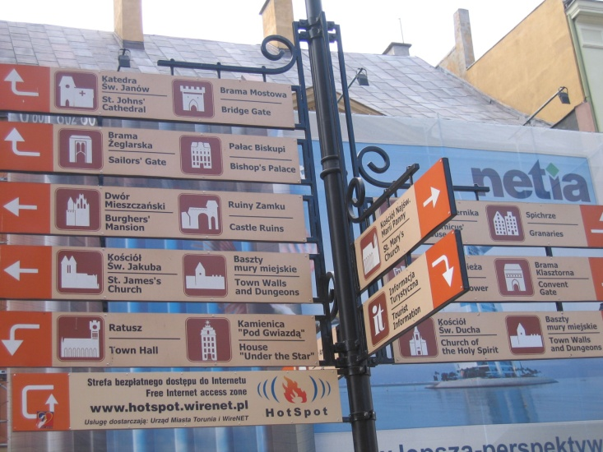
Be invited
to Toruń

Slide 36
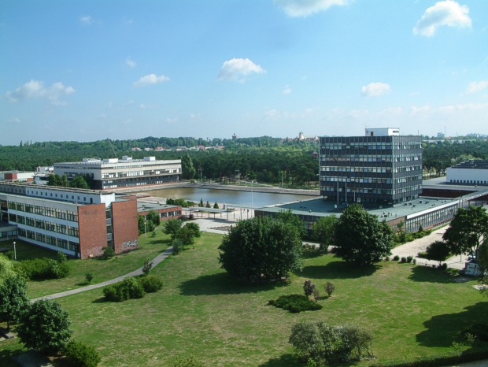
Thank you for your attention!

